Slide 1
Subreddit Hyperlink Network Analysis
CSS Final Project – by Elisabeth, Julie and William

Slide 2
The central idea and why is this interesting
Analyze which communities attack or support each other and what characterizes them.
Can these communities be inferred from just subreddit posts? Do the found communities make sense? Are there similar language patterns within the communities?

Slide 3
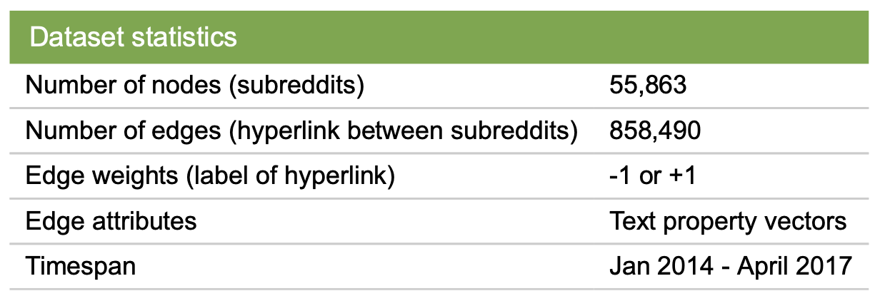
We explore our idea by combining the Reddit Hyperlink Network and the reddit subreddits dataset
Reddit Hyperlink Network
Reddit subreddits Information
Contains 4 .zst files about 22 million subreddits in January 2025
Subreddit meta data: 33 mb
Subreddit_rules: 67 mb
Subreddit wiki pages: 308 mb
Subreddit about pages and metadata: 2,24 gb
From academic torrent
Made up of posts that contain hyperlinks from one subreddit to another
Dataformat
Source Subreddit
Target Subreddit
Post_ID
Timestamp
Post Label: Explicity negative/positive toward target
Post Proterties
From Standford Large Networks Dataset Collection

Slide 4
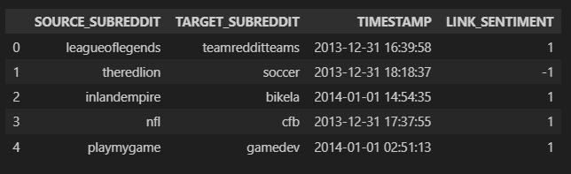
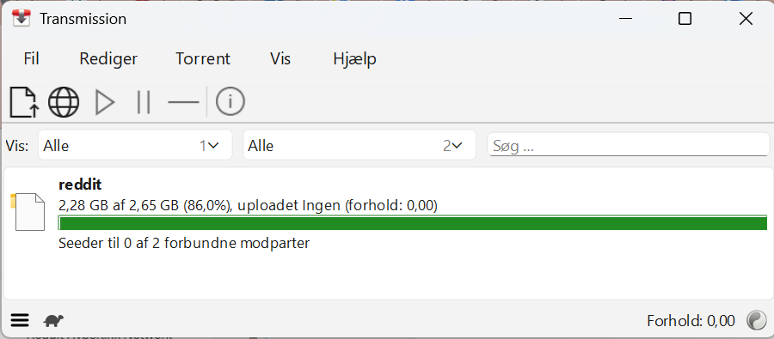
How did we download the data
Reddit Hyperlink Network download
df = pd.read_csv("../data/soc-redditHyperlinks-body.tsv", sep='\t’)
Filtered out irrelevant properties
Reddit subreddits metadata, rules and wikis 2025-01 download:
Transmission download kernel
Uploaded to a pandas dataframe using zstandard.
Kernel crashing -> buffer
45 MINUTES
11 000 subreddits in the union between datasets

Slide 5
Goal
Analyze positive and negative communities in the reddit hyperlink network including in/out degree analysis and graph-visualizations.
Analyze whether the topics/language are similar/different between positive and negative communities

Slide 6
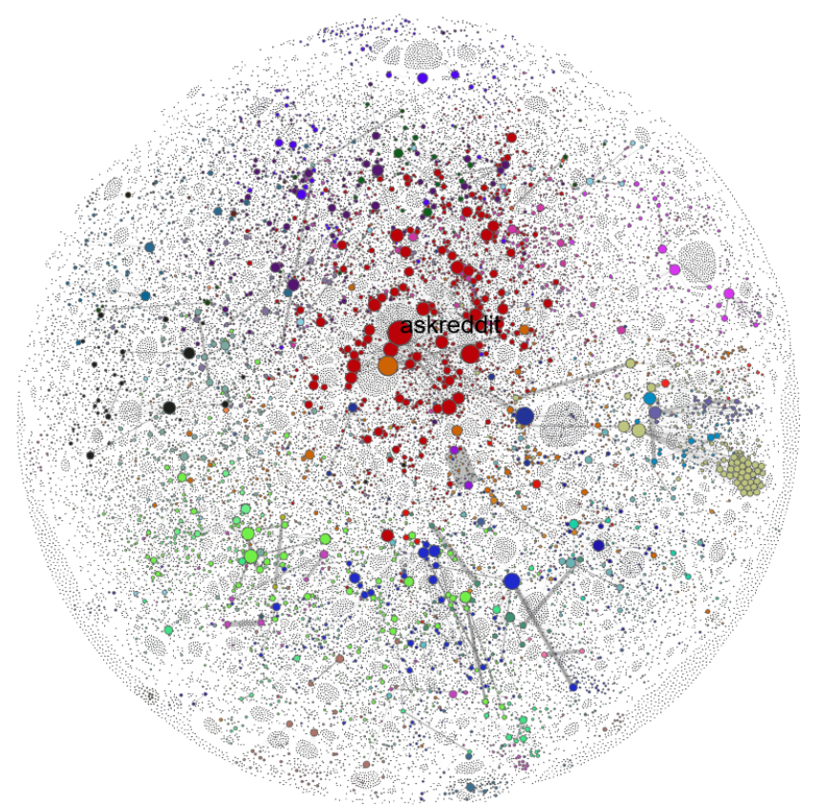
Implementation plan
Networks setup
1) Link the subreddit description as a node attribute for each subreddit in the network.
2) Make two networks with positive and negative links
3) Edge weights equal the number of links between the two subreddits.
4) Obtain the largest strongly connected component of each network
Network analysis
5) Identify communities of subreddits using louvain community detection.
6) Examine degree distribution of the networks
7) Visualize graphs
Text analysis
8) Examine the difference in language in the descriptions of positive and negative networks.
9) Extract the most common tokens
Topic Analysis
10) Extract topics using TF-IDF
11) Visualize the most common topics
MAYBE:
- Analyze the networks over time (since the network contains the time_stamps)
Notes:
Make a network with only positive links and a network with only negative links.
Use the amount of positive or negative links between each subreddit as edge weighting.
Identify communities of subreddits in the positive network using network community detection.
Examine the degree distribution in the negative network:
Do specific subreddits have a high out-degree (they hate a lot) or a high in-degree (they get hated a lot)?
For a specific community (maybe biggest connected?):
Extract topics and analyze keywords using TF-IDF.
Examine language and sentiment patterns in positive versus negative links.
Maybe analyze the networks over time (since the network contains the time_stamps)

